Slide 1

Electronic Design Automation #2 Team 14
Presented to: Dr Eman Elmandouh Eng Kareem Waseem

Slide 2
Team Members
Mohamed Hany Mohamed Fadel
Ahmed Mohamed Elsheikh
Mazen Ahmed Galal
Kareem Ahmed Sameer
Basel Ashraf Fekry
Youssef Mahmoud Hassan
Saifeldin Mohamed Hatem
Omar Ahmed Salah

Slide 3

Table of contents
01
02
03
04
Intrduction
Parsing
TB Generation
Demonstration

Slide 4

01
Introduction

Slide 5

Automated Verilog Testbench Generator
A Paradigm Shift in Hardware Verification!

Slide 6
Brief explanation of the project
In this project, our team embarked on the creation of an Automatic Test Bench (TB) generator, aiming to streamline and automate the process of generating Verilog testbenches. The primary goal is to take a Verilog Design Under Test (DUT) as input and produce a fully-functional testbench capable of simulating the original hardware design.

Slide 7

Importance of Automated Testbenches
Highlighting the significance: Traditional hardware verification methods often involve time-consuming and error-prone manual testbench creation. Our automated approach addresses this challenge by intelligently parsing Verilog code, extracting crucial information, and generating a comprehensive testbench. This not only enhances efficiency but also ensures consistency and accuracy in the verification process.

Slide 8
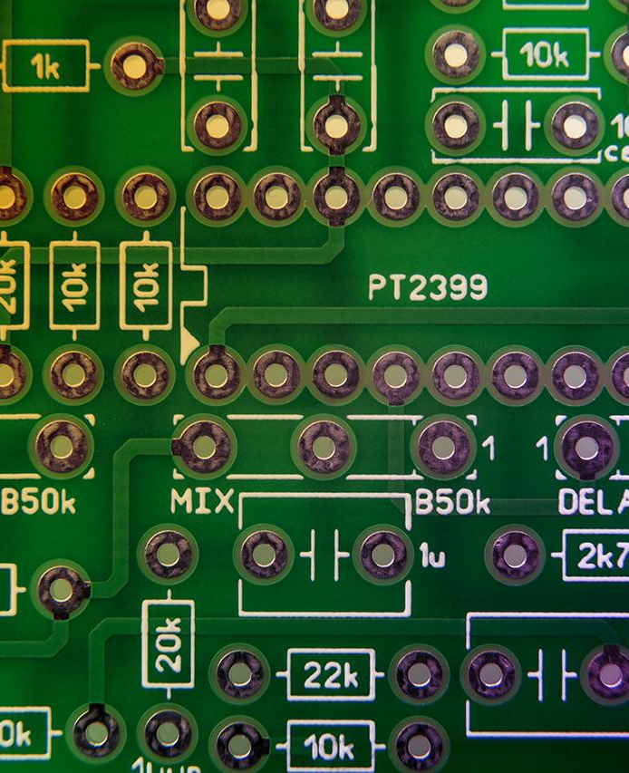
Key Components of the Automated Generator
Verilog Parser:
TB Writer:
A tool designed to meticulously analyze the Verilog code of the DUT, extracting critical elements such as module details, input/output ports, control flow structures, and more.
The module that assembles the final testbench. It includes the generation of an initial block for variable initialization, clock generation, DUT instantiation, test stimulus generation using always/initial blocks with appropriate time delays, and the addition of display and monitor statements for result validation.
Stimulus Generator
The engine responsible for creating stimuli for the testbench. It utilizes a mix of directed tests and $random Verilog functions to generate diverse and comprehensive test scenarios.

Slide 9

Language and Tools Used
Python
We used python 2.7.61 as the primary programming language The choice of Python for its versatility and ease of integration in hardware design workflows.
QuestaSim
Usage of QuestaSim for simulation

Slide 10

02
Parser

Slide 11
What we parse ?
01
02
03
Inputs and Outputs
Case Statements
Logical Equations
04
Blocking Assignments
05
06
Non Blocking Assignments
If Statements
07
Vector Size Calculation

Slide 12

Module Input and output parser
This function plays a pivotal role in extracting critical information about module ports, simplifying the understanding of input and output characteristics
The function begins by splitting the data type of each port into a list for detailed analysis
Through a check, if the data type contains "reg," it is marked as a register (d_t = "reg").
This ensures the accurate classification of the type of data being processed.

Slide 13

Case Statements parser
The parse_case_statements function serves to identify and analyze Verilog case statements within a module's body. Utilizing regular expressions, it captures both the condition and body of each case, filtering out extraneous characters to isolate individual case members. These members, representing potential case values, are then integrated into the Verilog module via the verilog_module.add_Cases function.
The function meticulously excludes unnecessary characters and keywords during member extraction. By filtering out symbols like logical operators, parentheses, and braces

Slide 14
Logical Equation parser
The parse_logical_equations function is designed to analyze lines of Verilog code, specifically focusing on logical equations. It identifies logical operators such as '&', '|', '!', '~', '^’,’&&’, and ‘||’. The function employs a nested structure, with an internal is_operator function to check whether a character is a logical operator. Additionally, it utilizes the extract_operands function to isolate operands from the expression while excluding specified characters.

Slide 15
Blocking assignment parser
The parse_assignment_blocking function is designed to analyze Verilog code and specifically handle blocking assignments. It efficiently parses the provided Verilog code, identifies lines containing the '=' operator, and extracts information about the left-hand side (LHS) and right-hand side (RHS) of each blocking assignment.
The function splits the Verilog code into lines and iterates through each line to locate the '=' operator using the find method. Upon finding a line with an '=', it proceeds to extract the LHS and RHS of the assignment. The LHS is determined by locating the last word before the '=' symbol in the line.

Slide 16
Non Blocking assignment parser
The parse_assignment_non_blocking function is designed to analyze Verilog code and specifically handle non-blocking assignments. This function efficiently parses the provided Verilog code, identifies lines containing the '<=' operator, and extracts information about the left-hand side (LHS) and right-hand side (RHS) of each non-blocking assignment.

Slide 17
If statement parser
The parse_if_statements function is designed to analyze Verilog code and specifically target if statements within the provided module body. It utilizes regular expressions to locate if statements and extracts the conditions associated with each if statement. The extracted conditions are then processed to identify and isolate individual members, excluding certain characters and keywords.
The function uses regular expressions to find if statements, capturing the conditions within parentheses. It then refines the condition by stripping unnecessary whitespace and filtering out irrelevant characters and keywords. The resulting list of members represents the identifiers involved in the if condition.

Slide 18
Vector Size parser
The vector_size function serves the purpose of determining the size of a vector in a given Verilog line. It leverages regular expressions to identify if square bracket notation (indicating a vector) exists in the line. If brackets are found, the function extracts the left and right values of the range using regular expressions. It calculates the vector size by taking the absolute difference between the right and left values, then adding 1 to account for inclusive counting.

Slide 19
03
TB generator

Slide 20
What we parse ?
01
02
Logical Test Generation
Blocking Assignment Test Generation
04
05
Case Test Generation
Non-Blocking Assignment Test Generation
03
If Test Generation
06
Random Test Loop Generation
07
08
Monitor Block Generation
Clock Generation

Slide 21
Logical test Generation
This function focuses on generating test cases for logical operators. It iterates through the logical members of a module, randomizes input values for those members, and includes reset toggling if reset exists. The testbench is enriched by displaying the time and values during execution.

Slide 22
Blocking assignment Generation
This function specializes in creating test scenarios for blocking assignments. It identifies input ports in the right-hand side (RHS) of assignments, randomizes their values, includes reset toggling if reset exists, and incorporates delays between actions. The testbench output includes time and relevant signal values.

Slide 23
If Statement test Generation
This function is Focused on generating test cases for if statements, this function randomizes values for input ports, includes reset toggling if reset exists, and adds delays. It enhances the testbench by displaying the time and values during execution.

Slide 24
Case Test Generation
This function handles the generation of test cases for case statements. It randomizes values for input ports in both random and specific case scenarios. The testbench includes reset toggling if reset exists, time tracking, and output display for relevant signals.

Slide 25
Non Blocking Test generation
This function is dedicated to generating test cases for non-blocking assignments. Similar to generate_ba_test, it identifies input ports in the RHS, randomizes their values, toggles resets if reset exists , and adds delays. The resulting testbench output provides time and signal values.

Slide 26
Random Test generation
This function creates a loop for fully random testing, iterating through a specified number of loop_iterations. It randomizes values for all input ports, incorporating delays and displaying the time and signal values during execution.

Slide 27
Monitor Block Test Generation
This function generates a monitor block within the initial block of the testbench. It displays simulation time and output values during the testbench execution, providing a comprehensive view of the module's behavior.

Slide 28
Clock Test generation
This function establishes an initial block that initializes the clock to zero. If the module involves a clocked element, it perpetually toggles the clock value with a delay equivalent to half the clock period.

Slide 29

04
Demonstration
You can enter a subtitle here if you need it

